Slide 1

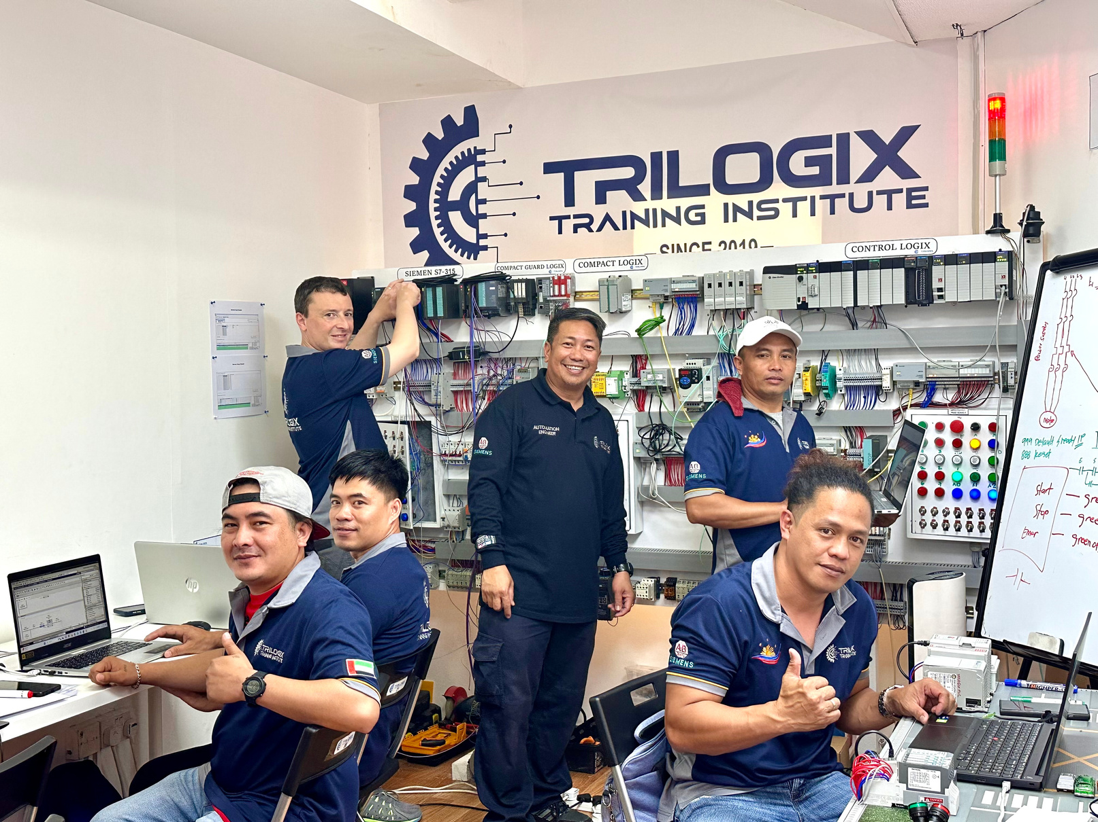
PRESENTATION
SOLAR CHARGE CONTROLLER
TRILOGIX TRAINING INSTITUTE

Slide 2
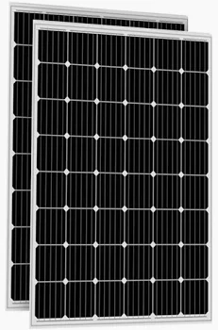
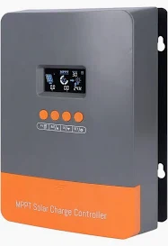
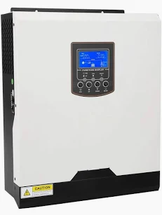
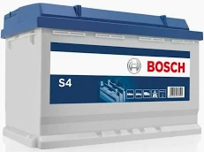
INTRODUCTION
Charge Controller
It protects the battery from overcharging and excessive discharging.
Inverter
PV Modules
It converts DC to AC electricity.
It captures solar power and produces DC electricity.
Storage Battery
It stores electrical energy in the form of DC electricity.

Slide 3

ENERGY FLOW AND UNIT ANALYSIS
V x A
A
kW
V x Ah = kWh
Charge Controller
PV Modules
Storage Battery
PSH = 4 hours (h)

Slide 4
ENERGY FLOW AND UNIT ANALYSIS
60 A
1375 W
5.5 kWh
24 V
229 Ah
Charge Controller
PV Modules
Storage Battery
PSH = 4 hours (h)

Slide 5
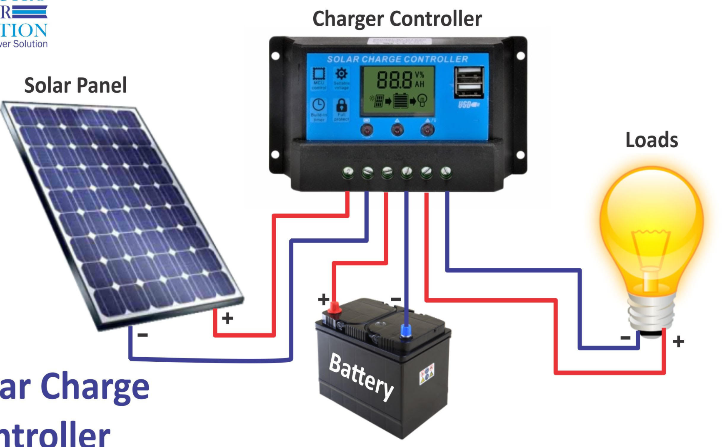
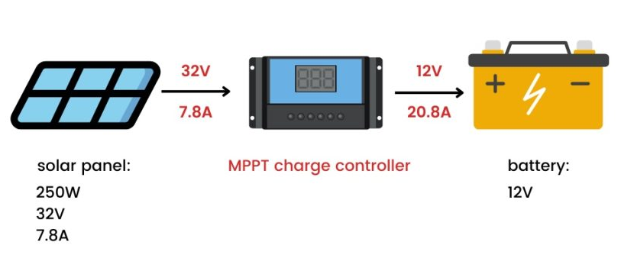
SOLAR CHARGE CONTROLLER
A solar charge controller (SCC) controls the flow the charge from the battery and to the battery.
SCC protects the battery by preventing over-charge or deep discharge of batteries to preserve their life and performance.
When the battery gets overcharge or goes into deep discharge or over-discharge, a charge controller will cut it off from the circuit.
SCCs are rated according to the maximum PV input voltage (V) and maximum charge current (A).

Slide 6
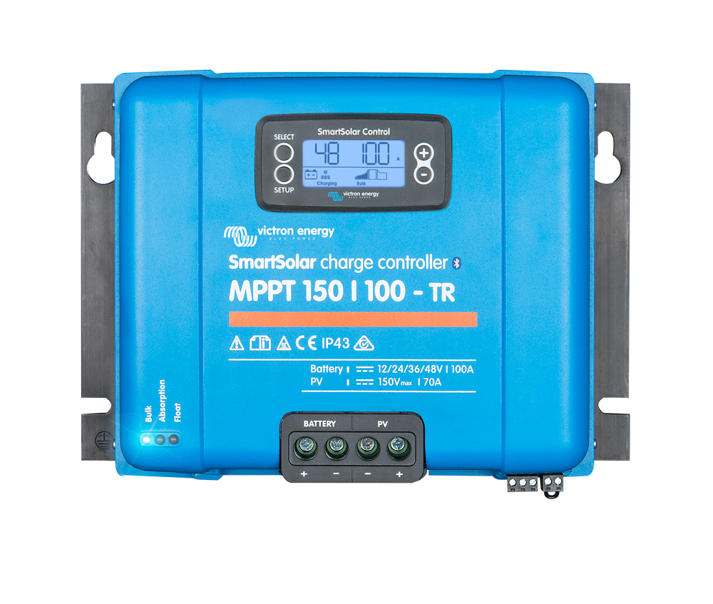
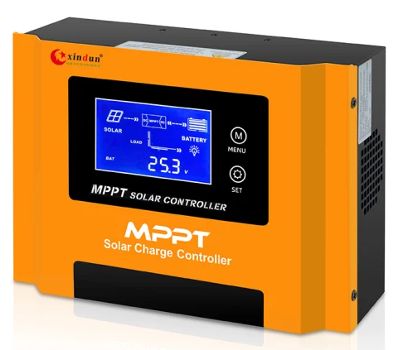
SOLAR CHARGE CONTROLLER
How to choose Solar Charge Controller?
Charge Current Rating
Types of Charge Controller
PV Input Power and Voltage
Battery Voltage or System Voltage
Battery Types Supported
Load or Output Current
Features and Parameters

Slide 7
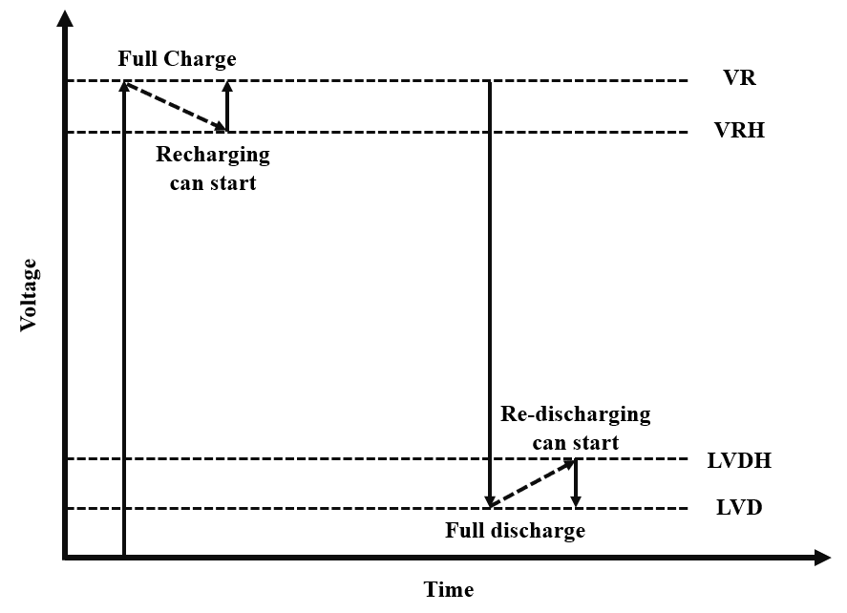
SCC TYPICAL PARAMETERS
Nominal system voltage: This voltage represents the voltage at which the charge controller and the battery operate in a solar PV system. (12V, 24, 48V)
Nominal Load current: This represents the maximum load current that a charge controller should handle.
Nominal PV array current: This represents the maximum PV array current that the charge controller should be able to handle. (1.25 x Isc of PV array)

Slide 8
SCC TYPICAL PARAMETERS
Charge regulator setpoints: it takes decisions either to connect or disconnect the load or charging source.
Voltage regulation setpoint (VR): the controller will disconnect the battery bank from the PV source or it may regulate the current supplies to the batteries.
Voltage regulation hysteresis (VRH): This represents the difference between the VR and the voltage at which the charge controller will reconnect the battery to the PV source for charging.

Slide 9
SCC TYPICAL PARAMETERS
Low voltage disconnect (LVD): This is also known as the depth of discharge (DOD) of a battery. It is strongly recommended to avoid discharge below this level to avoid the deterioration of the life and performance of the battery.
Low voltage disconnect hysteresis (LVDH): This represents the difference between the LVD and the voltage at which the battery can be reconnected to the load.

Slide 10
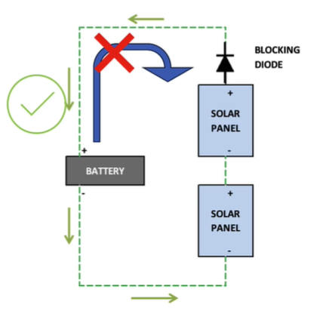
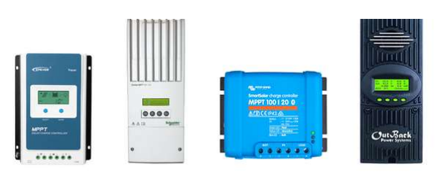
SCC ESSENTIAL FEATURES
Overload protection: Charge controllers have the essential role of protection against overload. If the current flowing into your battery is far higher than the circuit can handle, your device can overload. It can lead to overheating or even explosions.
Blocks the flow of Reverse Currents: Solar panels send the current through the battery in single direction. At night, panels can, of course, transfer some of the charges in reverse order. It can trigger a minor discharge of the battery. Load controls avoid this from occurring by serving as a valve.

Slide 11
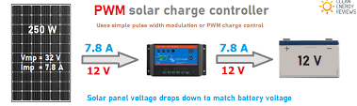
TYPES OF CHARGE CONTROLLER
Pulse Width Modulation (PWM) charge controller
current is drawn out of the PV module below Vmp and just above the battery voltage.
Maximum Power Point Tracking (MPPT) charge controller
current is drawn out of the PV module at Vmp and convert the excess voltage to charging current.

Slide 12
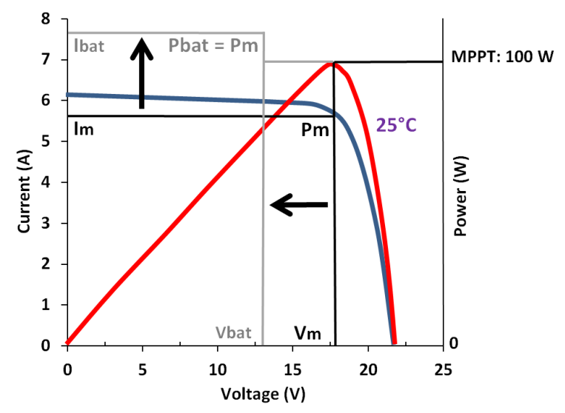
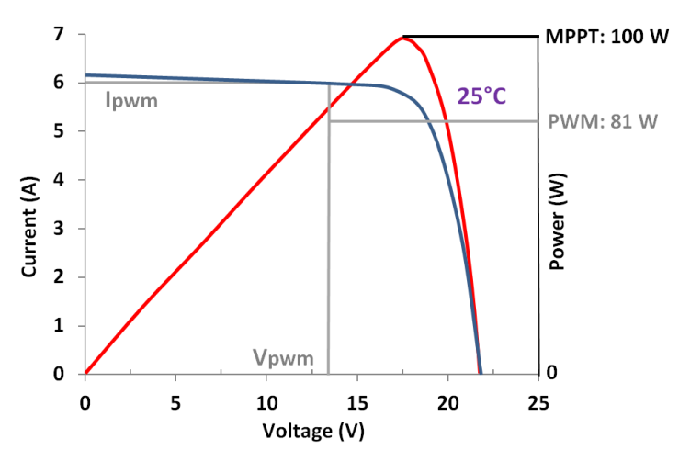
PWM VS MPPT
PWM charge controller
MPPT charge controller
Pmax = Vmp x Imp = 18 V x 5.6 A = 100 W
Pbat = Vbat x Ibat = 13.5 V x 6 A = 81 W
Pmax = Vmp x Imp = 18 V x 5.6 A = 100 W
Pbat = Vbat x Ibat = 13.5 V x 7.4 A = 100 W

Slide 13
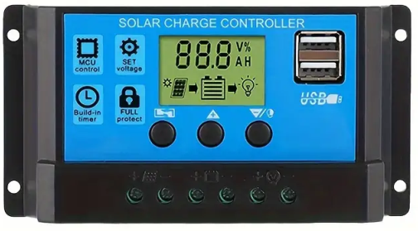
PWM VS MPPT
Pmax = 100 W
Vmp = 18 V
Im = 5.6 A
Vpwm = 13.5 V
Ipwm = 6 A
Ppwm = 81 W
Vmppt = 13.5 V
Imppt = 7.4 A
Pmppt = 100 W
13.5 V
Charging Voltage
13.5 V
Nominal Voltage:12 V

Slide 14
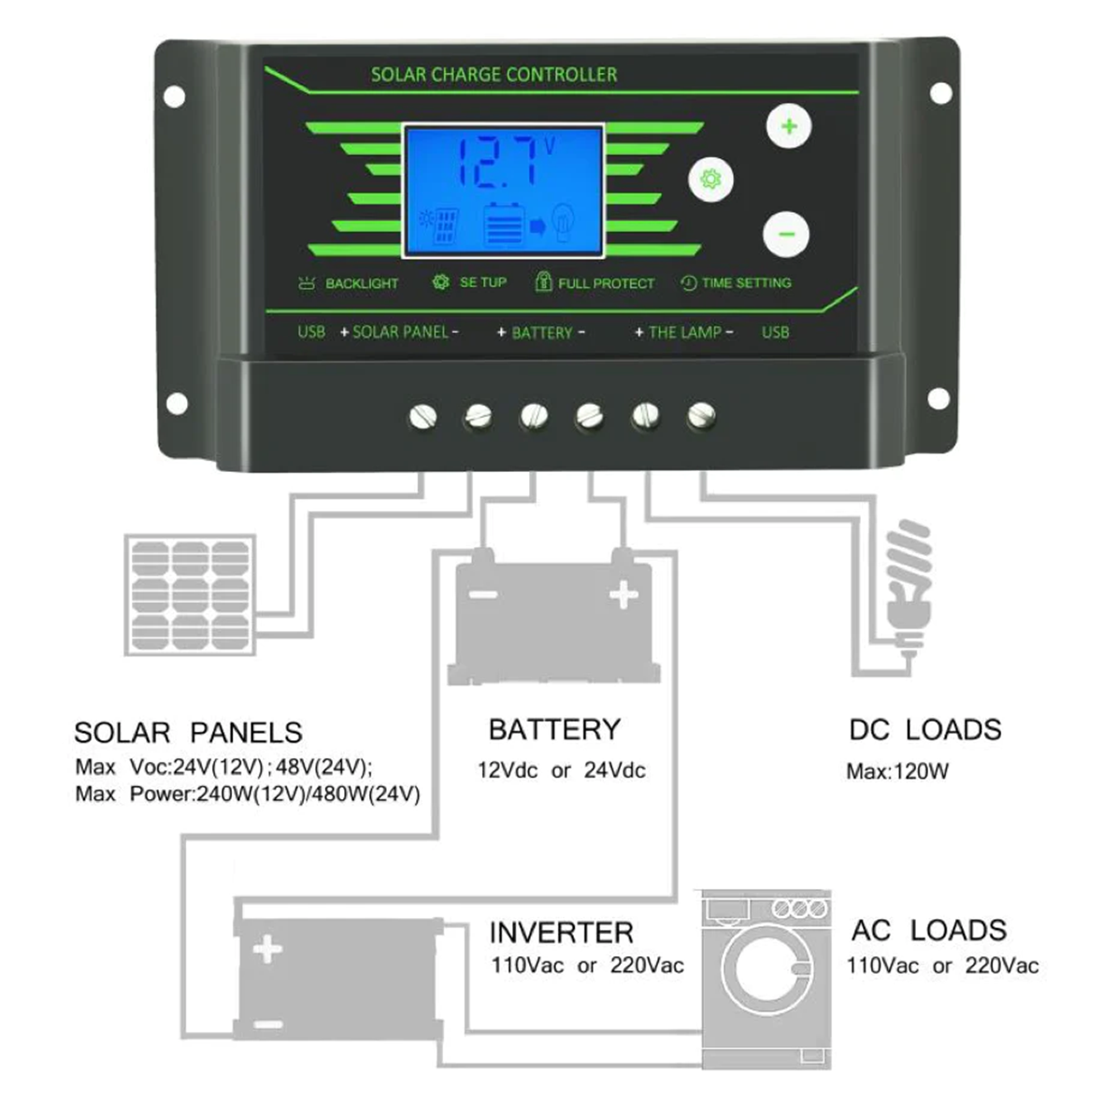
PWM CHARGE CONTROLLER
Consider buying PWM if:
Small setup
Panel’s nominal voltage is close to the battery voltage.
Limited budget ($20-$60)
Power loss is not significant (75-80% efficiency)
The best panel match for a PWM controller:
18Vmp for a 12V battery
32Vmp for a 24V battery
48Vmp for a 36V battery
64Vmp for a 48V battery

Slide 15
PWM AND PV MODULE MATCHING
PWM Rated Current > PV Input Isc
PWM Max Voc > PV Voc

Slide 16

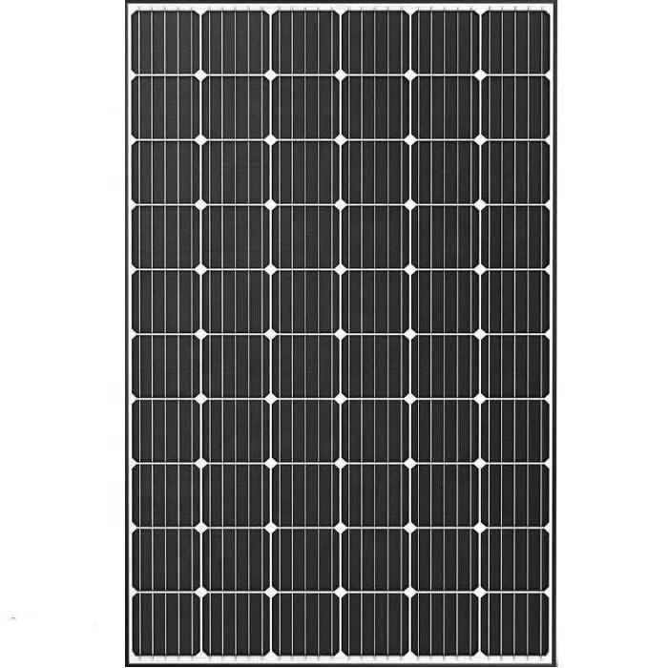
PWM AND PV MODULE MATCHING
PWM Rated Current > PV Input Isc
PWM Max Voc > PV Voc

Slide 17
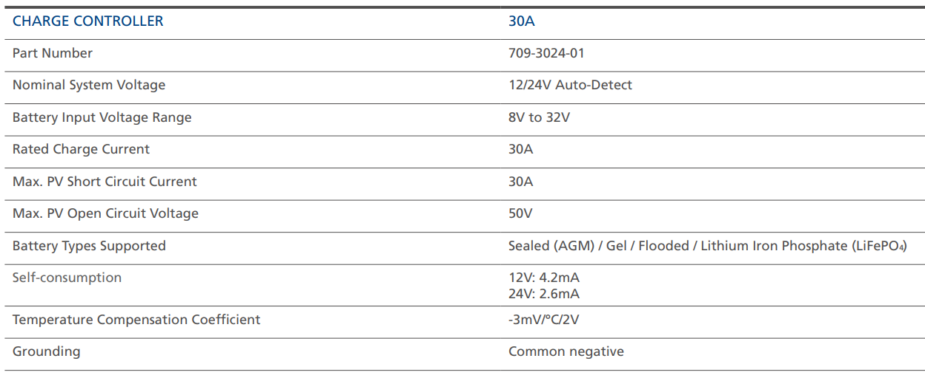
PWM CHARGE CONTOLLER

Slide 18
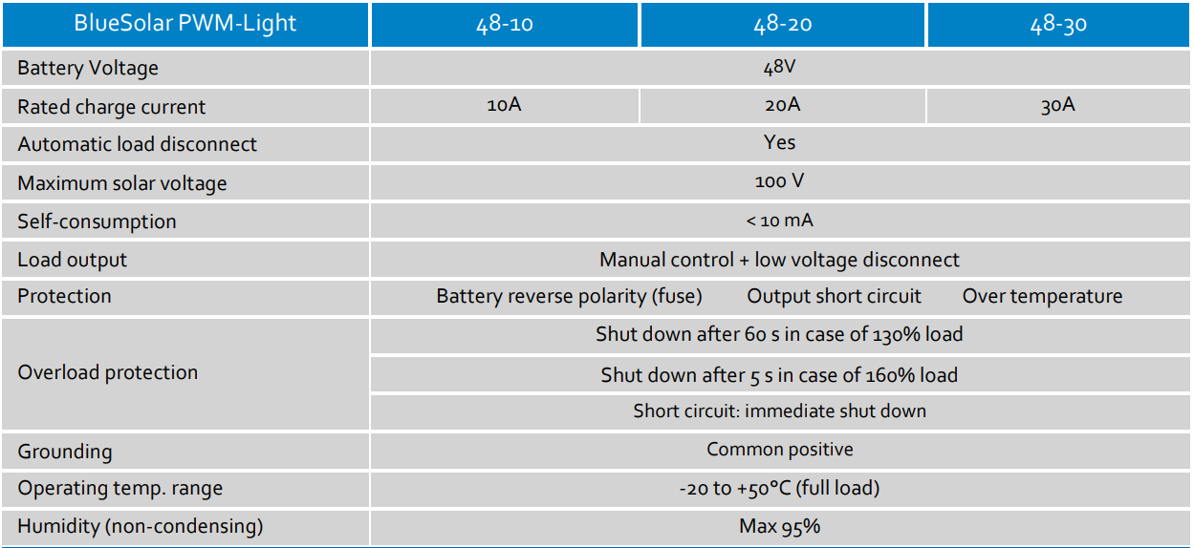
PWM CHARGE CONTOLLER

Slide 19
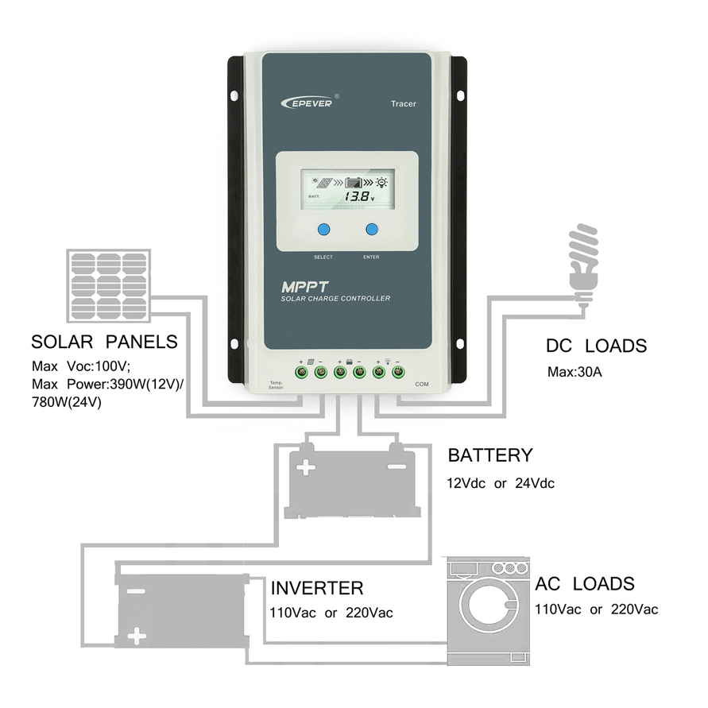
MPPT CHARGE CONTOLLER
MPPT charge controllers operates at maximum power voltage of the solar panel which provides 5-25% more efficiency than the PWM and thus usually more expensive than PWM controllers. ($100-$729)
The MPPT Controller is Best:
For larger systems where the additional 20% or more energy harvesting is worthwhile
When the solar array voltage is substantially higher than the battery voltage

Slide 20
MPPT CHARGE CONTOLLER
To match a panel to an MPPT controller:
The panel open circuit voltage (Voc) must be under the permitted voltage.
The Voc must be above the “start voltage” for the controller to “kick in”
The maximum panel short circuit current (Isc) must be within the range specified
The maximum array wattage should be less than the rated PV input - some controllers allow this to be “over-sized”

Slide 21
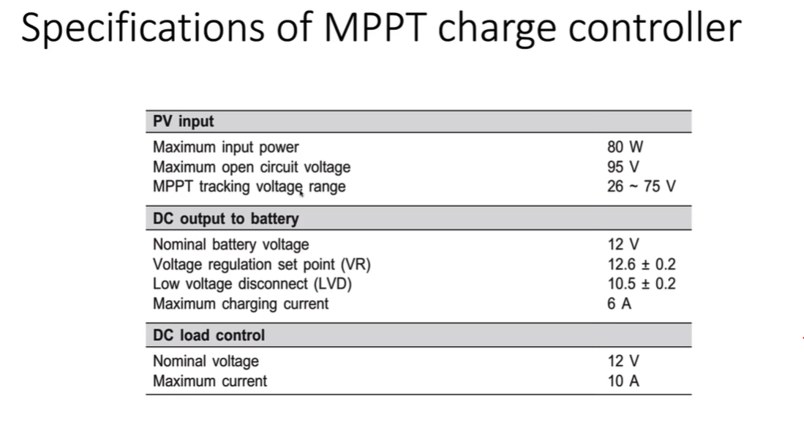
MPPT CHARGE CONTOLLER
PV Input Specifications:
Maximum input power: This represents the maximum power that the MPPT charge controller can handle from the connected PV array.
Maximum open circuit voltage: This represents the maximum open-circuit voltage that the MPPT charge controller can handle.
MPPT tracking voltage range: This represents the voltage level range that the MPPT charge controller can handle.

Slide 22
MPPT AND PV MODULE MATCHING
MPPT Max Power Input > PV Pmax
MPPT Max Voc > PV Voc
MPPT Max Voltage Range > PV Vmp> MPPTT Min Voltage Range

Slide 23
MPPT AND PV MODULE MATCHING
MPPT Max Power Input > PV Pmax
MPPT Max Voc > PV Voc
MPPT Max Range > PV Vmp> MPPTT Min Voltage Range
MPPT Input Current > PV Isc

Slide 24
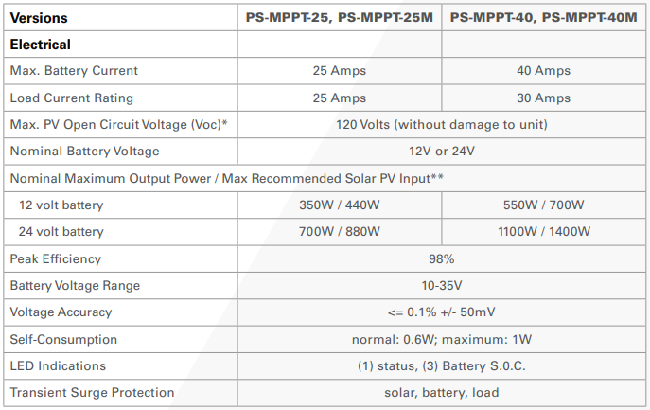
MPPT CHARGE CONTOLLER

Slide 25
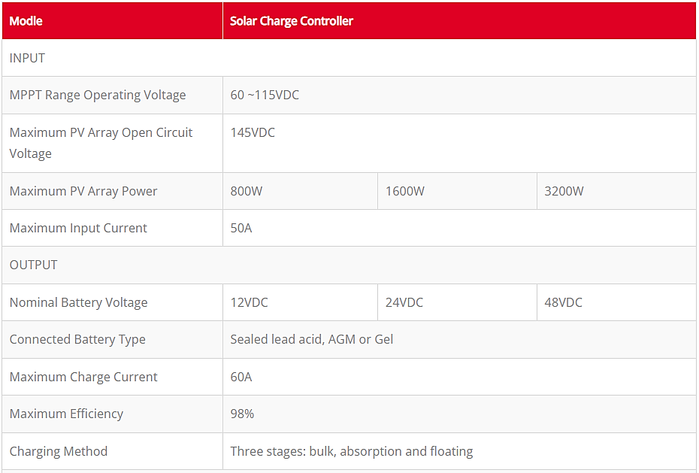
MPPT CHARGE CONTOLLER

Slide 26
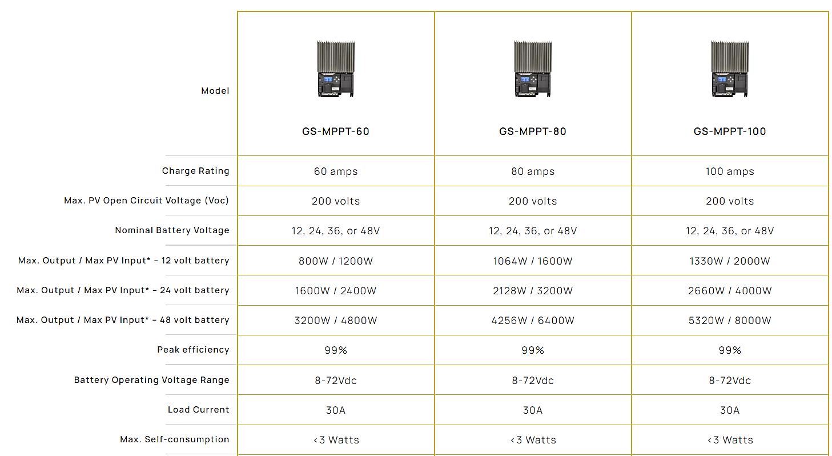
MPPT CHARGE CONTOLLER
*The PV array power rating may exceed the controller’s Max Nominal Output Power specification by approximately 150%. The controller will limit battery current and prevent damage. Array oversizing should be considered on a case by case basis.

Slide 27
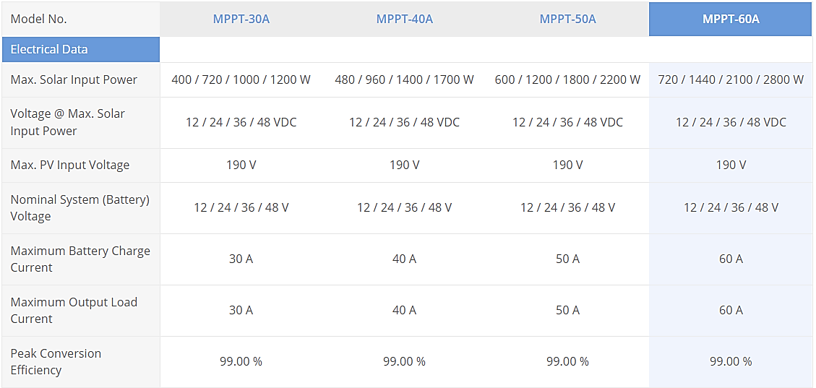
MPPT CHARGE CONTOLLER

Slide 28
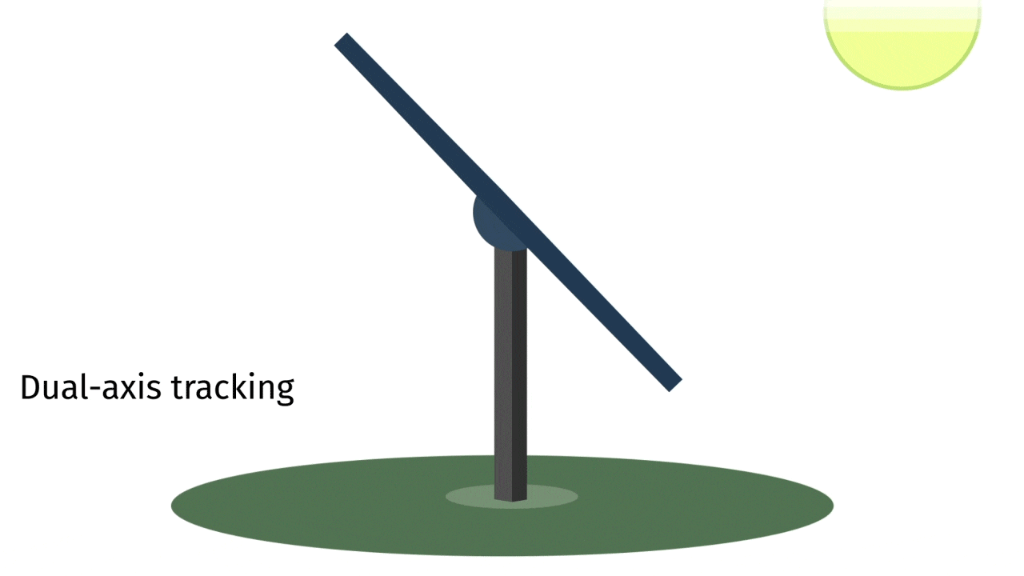
MPPT AND SUN TRACKING
It should be noted that the MPPT is not the same as the sun-tracking of solar PV modules.
In sun-tracking, PV module are rotated mechanically so that the radiation absorbed by a module is maximum. While in the case of MPPT, electronic circuitry is used to ensure that maximum amount of generated power is transferred to the load.

Slide 29
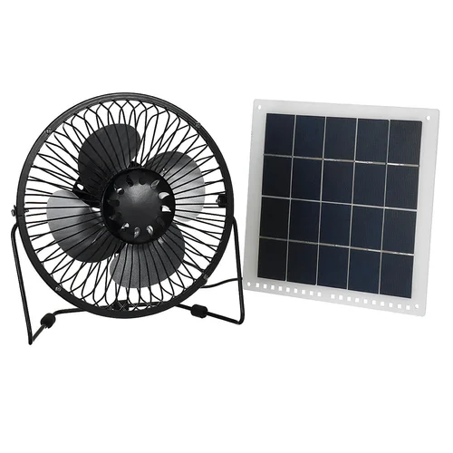
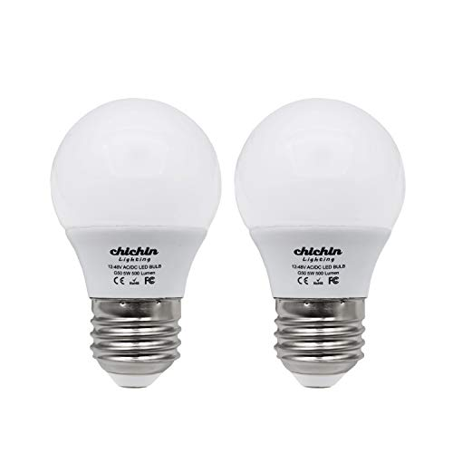
EXAMPLES
A house has the following DC loads rated at 12V.
Three 40W lights
A 50W fan
All the loads are to be powered simultaneously using two parallel connected modules. Each module has peak current of 2.5A and short circuit current of 3.5A. Choose the appropriate PWM charge controller.
Isc = 3.5 A
Imp = 2.5 A
PWM Charge Controller
PV Input Current = ?
1-50W
3-40W
Load Output Current = ?
2 X
Total Isc = ?
Total Load Power= ?
Total Imp = ?

Slide 30
EXAMPLES
A house has the following DC loads rated at 12V.
Three 40W lights
A 50W fan
All the loads are to be powered simultaneously using two parallel connected modules. Each module has peak current of 2.5A and short circuit current of 3.5A. Choose the appropriate PWM charge controller.
Isc = 3.5 A
Imp = 2.5 A
PWM Charge Controller
PV Input Current ≥ 7 A
1-50W
3-40W
Load Output Current ≥ 14.7 A
2 X
Total Isc = 7 A
Total Load Power= 170 W
Total Imp = 5 A

Slide 31
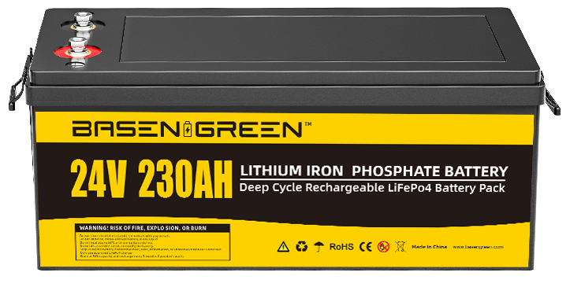
EXAMPLES
Consider a 1000-watt solar panel that operates at 48 volts DC and battery bank at 24 volts DC. Choose the MPPT charge controller ratings for this system. Wattage input by solar panel to MPPT charge controller is 1000W.
Pmax = 1000 W
Vmp = 48 V
PV Input Power ≥ 1000 W
PV Input Voltage ≥ 48 V
Nominal Voltage = 24 V
Output Current = 1.25 x 1000W/24V
≥ 52 A

Slide 32
BASIC SETTINGS OF SCC
Battery Floating Charging Voltage – This voltage keeps the battery at full charge and stops it from losing power on its own.
12 V system = 13.7 V
24 V system = 27.4 V
48 V system = 58.4 V
Battery Over-Discharging Protection Voltage – This is the voltage that prevents the battery from losing too much charge.
12 V system = 10.8 V to 11.4V (11.2 V)
24 V system = 21.6V to 22.8V (22.2 V)
48 V system = 43.2V to 45.6V (44.4 V)

Slide 33
BASIC SETTINGS OF SCC
Battery Overcharging Protection Voltage – Set this according to your battery type. It’s also called the full charge cutoff voltage.
12 V system = 14.1 V and 14.5 V (14.4 V)
24 V system = 28.2 V to 29 V (28.8 V)
48 V system = 56.4 V to 58 V (57.6 V)
Charge Controller Capacity – This is the maximum amount of current the controller can manage. It can be 10A, 20A, 30A, and so on, up to 100A.
Maximum Charging Current – This is the most current your solar panels can give. It’s what the batteries actually put out.
System Voltage – This refers to your solar power system’s operational voltage, like 12V, 24V, or 48V. Bigger systems might operate at 110V or 220V.

Slide 34
BASIC SETTINGS OF SCC
Temperature Compensation: Lithium batteries do not require temperature compensation, unlike other battery types. Ensure that this feature is disabled or set to the correct parameter for lithium batteries.
Equalization Settings: If you’ve previously been using lead batteries and you switch to lithium, it’s crucial to adjust the equalization settings. Lithium batteries don’t need equalization, and having it enabled can be detrimental to their lifespan and performance. On many charge controllers, you can disable the equalization feature.
Charging Profile: For optimal performance and battery lifespan, it’s essential to configure the charge controller with the appropriate settings for a lithium battery.

Slide 35
BASIC SETTINGS OF SCC
Charge Voltage: Set this to 14.4 volts, which is equivalent to 3.6 volts per cell (VPC).
Absorption Time: Adjust this to 30 minutes. This period ensures that the lithium cells are balanced correctly during the charging process.
Float Voltage: Set this value to 13.6 volts.
Resting Voltage: Typically, the default for this is 3.4 VPC.

Slide 36
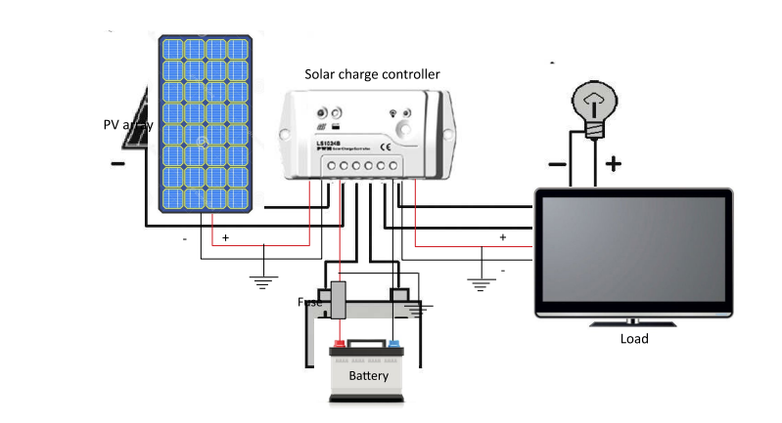
IMPORTANT NOTES
When installing a charge controller, it is recommended that you follow the sequence given below:
Connection sequence: connect the battery to the charge controller, followed by the PV module and lastly the loads.
Disconnection sequence: disconnect the load(s) from the charge controller first, followed by the PV module and lastly the battery.

Slide 37
ENERGY FLOW AND UNIT ANALYSIS
60 A
1375 W
5.5 kWh
24 V
229 Ah
Charge Controller
PV Modules
Storage Battery
PSH = 4 hours (h)

Slide 38
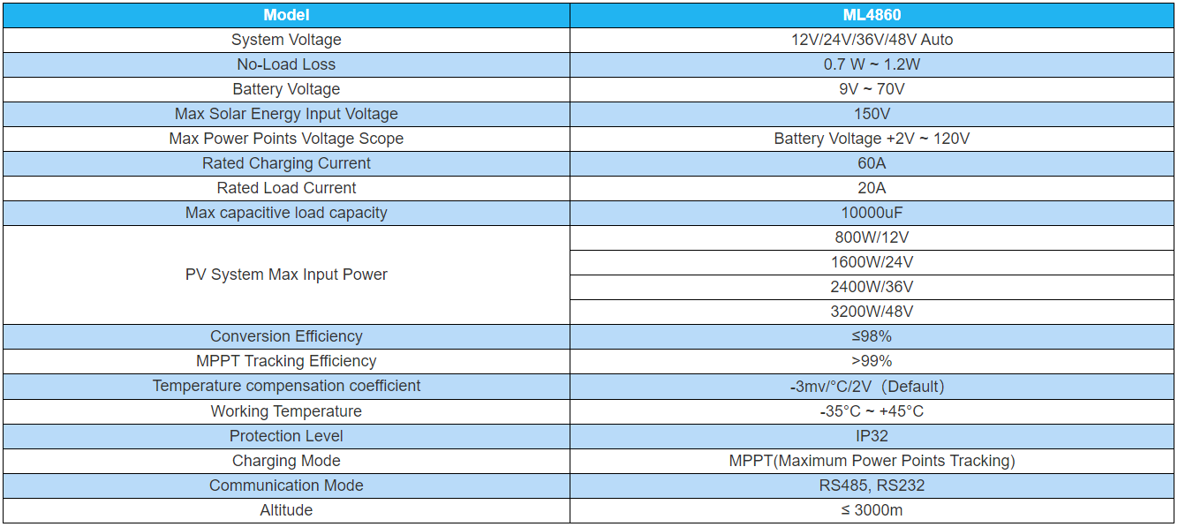
PV AND MPPT MATCHING

Slide 39
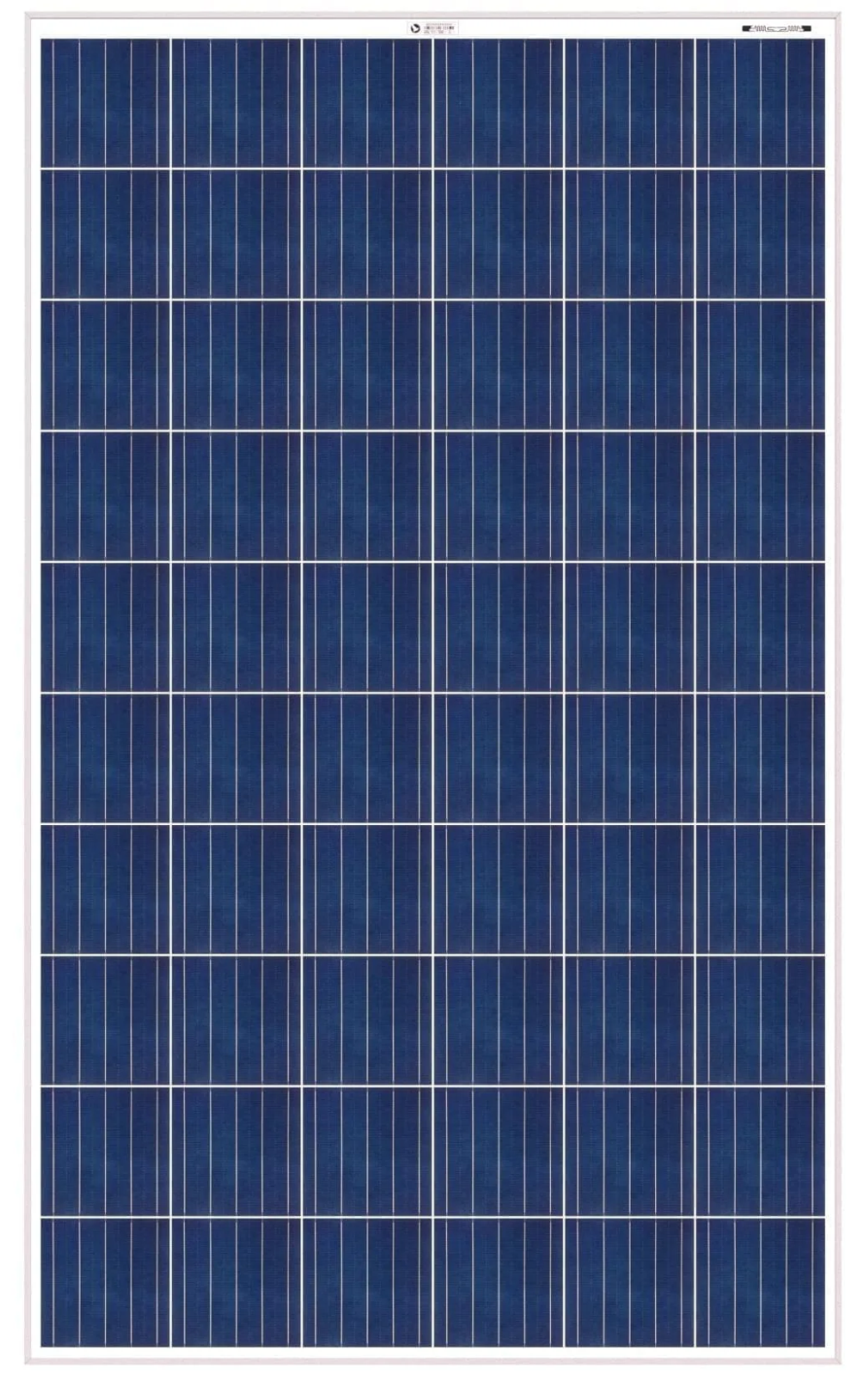
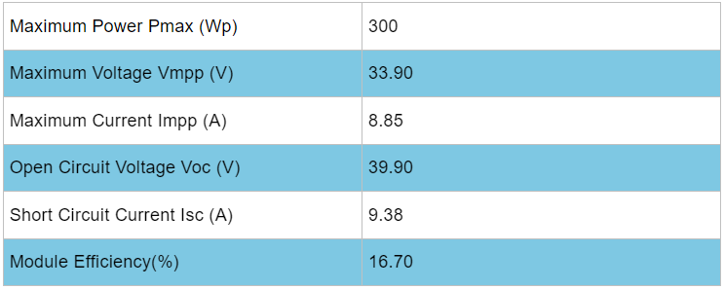
PV AND MPPT MATCHING
Pmax = 1500W (MPPT Max Input Power: 1600W)
Number of Panels = 1600W/300W = 5 Panels
Configuration: 5S
Total Voc = 199.5 V (MPPT Max Input Voltage: 150V)
Total Vmp = 169.5 V (MPPT Voltage Range: 26V- 120V)
Total Isc = 9.38 A
Total Imp = 8.85 A

Slide 40
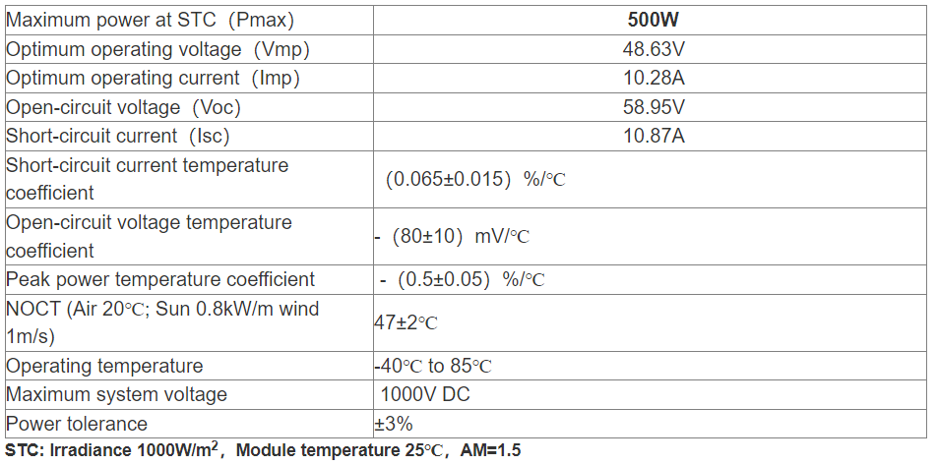
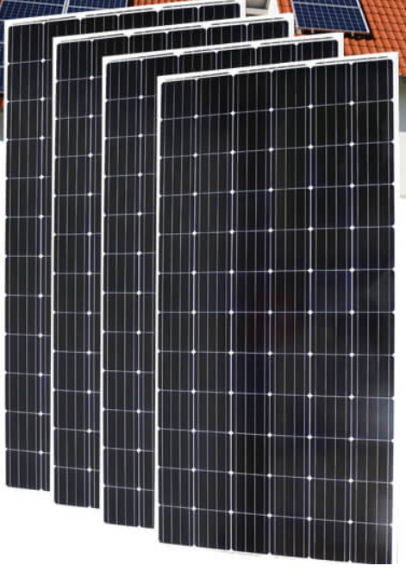
PV AND MPPT MATCHING
Pmax = 1500W (MPPT Max Input Power: 1600)
Number of Panels = 1600W/500W = 3 Panels
Configuration: 3S
Total Voc = 176.85 V (MPPT Max Input Voltage: 150V)
Total Vmp = 145.89 V (MPPT Voltage Range: 26V- 120V)
Total Isc = 10.78 A
Total Imp = 10.28 A

Slide 41
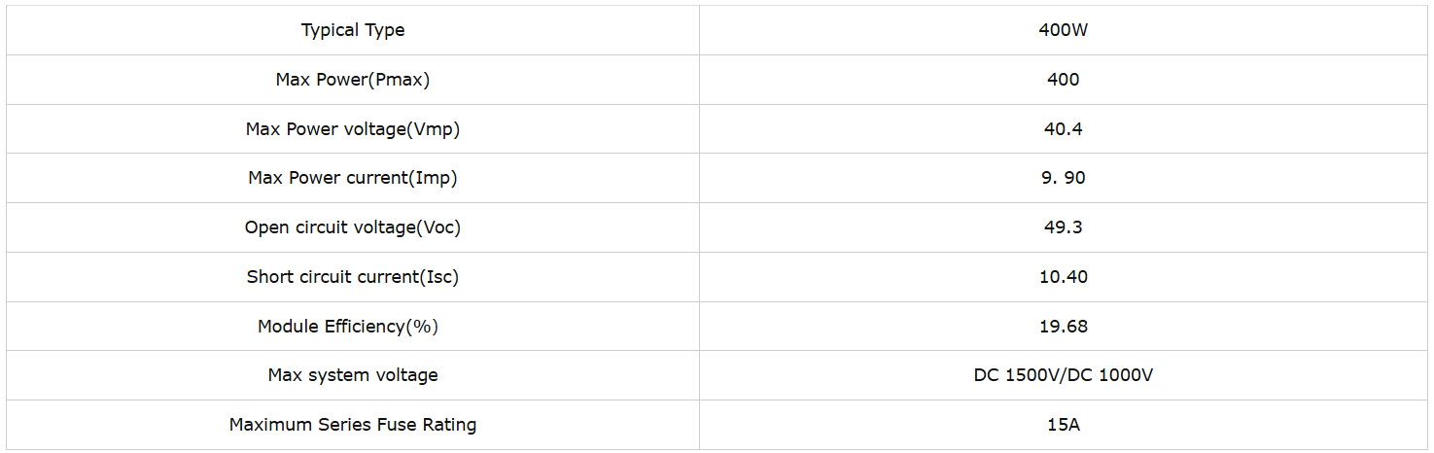
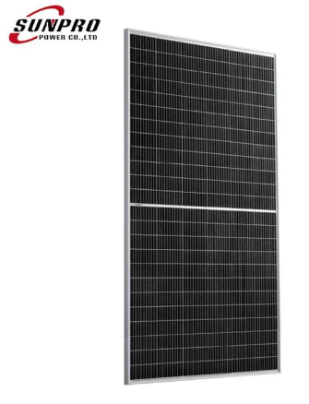
PV AND MPPT MATCHING
Pmax = 1600W (MPPT Max Input Power: 1600)
Number of Panels = 1600W/400W = 4 Panels
Configuration: 2S2P
Total Voc = 98.6 V (MPPT Max Input Voltage: 150V)
Total Vmp = 80.8 V (MPPT Voltage Range: 26V- 120V)
Total Isc = 20.80 A
Total Imp = 19.8 A

Slide 42
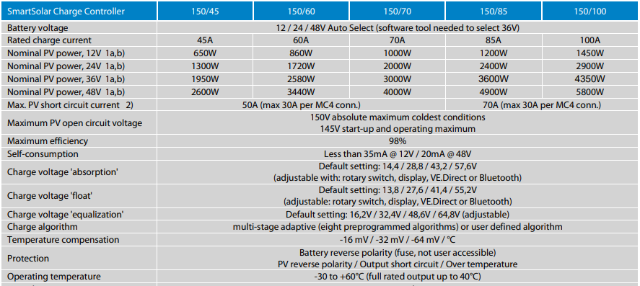
SCC REFERENCE

Slide 43
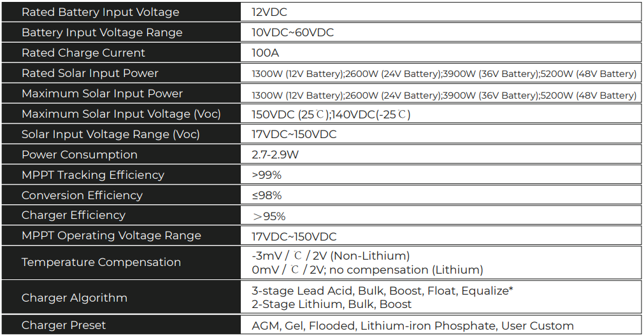
SCC REFERENCE

Slide 44
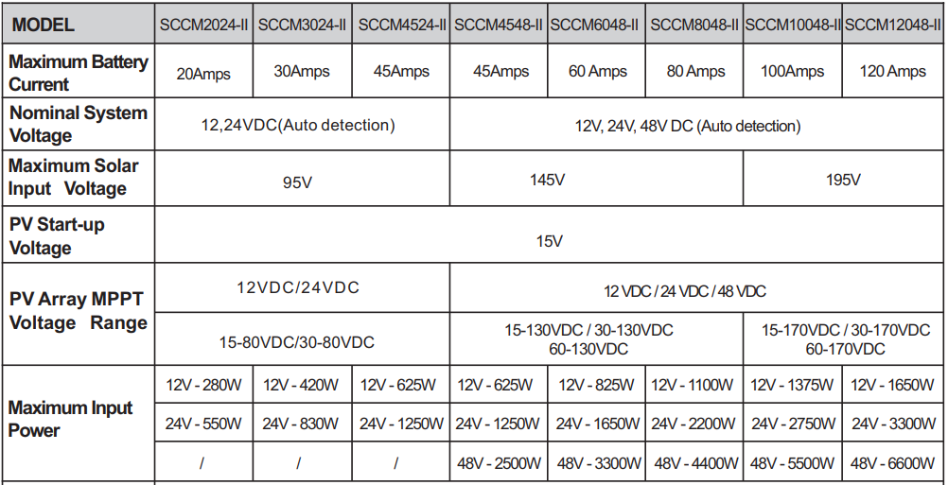
SCC REFERENCE

Slide 45
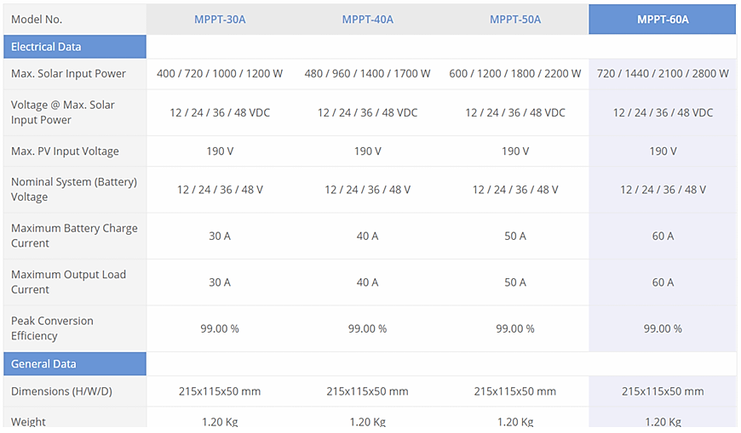
SCC REFERENCE

Slide 46
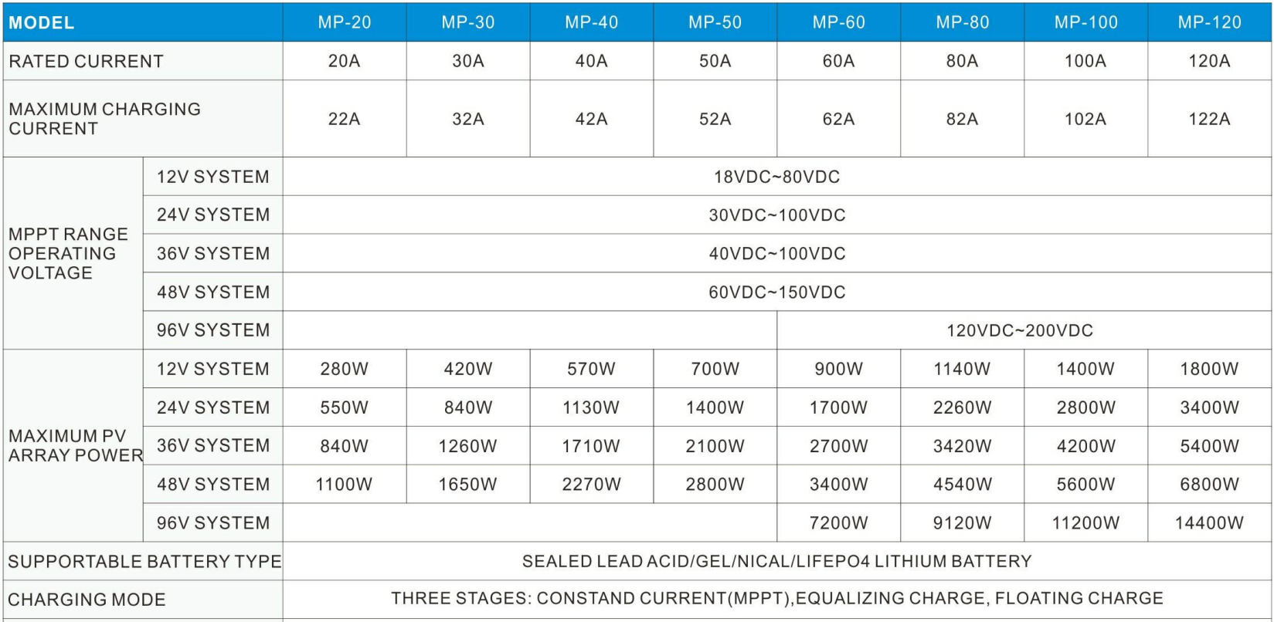
SCC REFERENCE

Slide 47
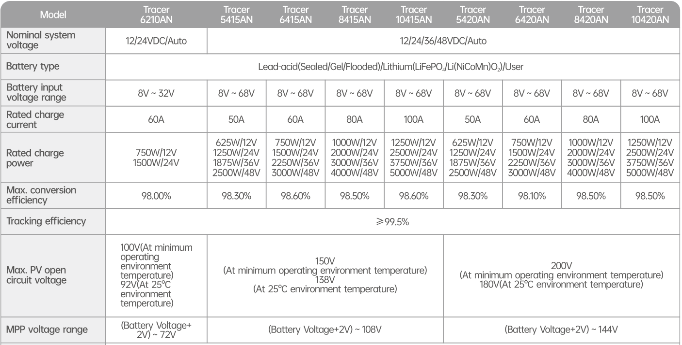
SCC REFERENCE

Slide 48
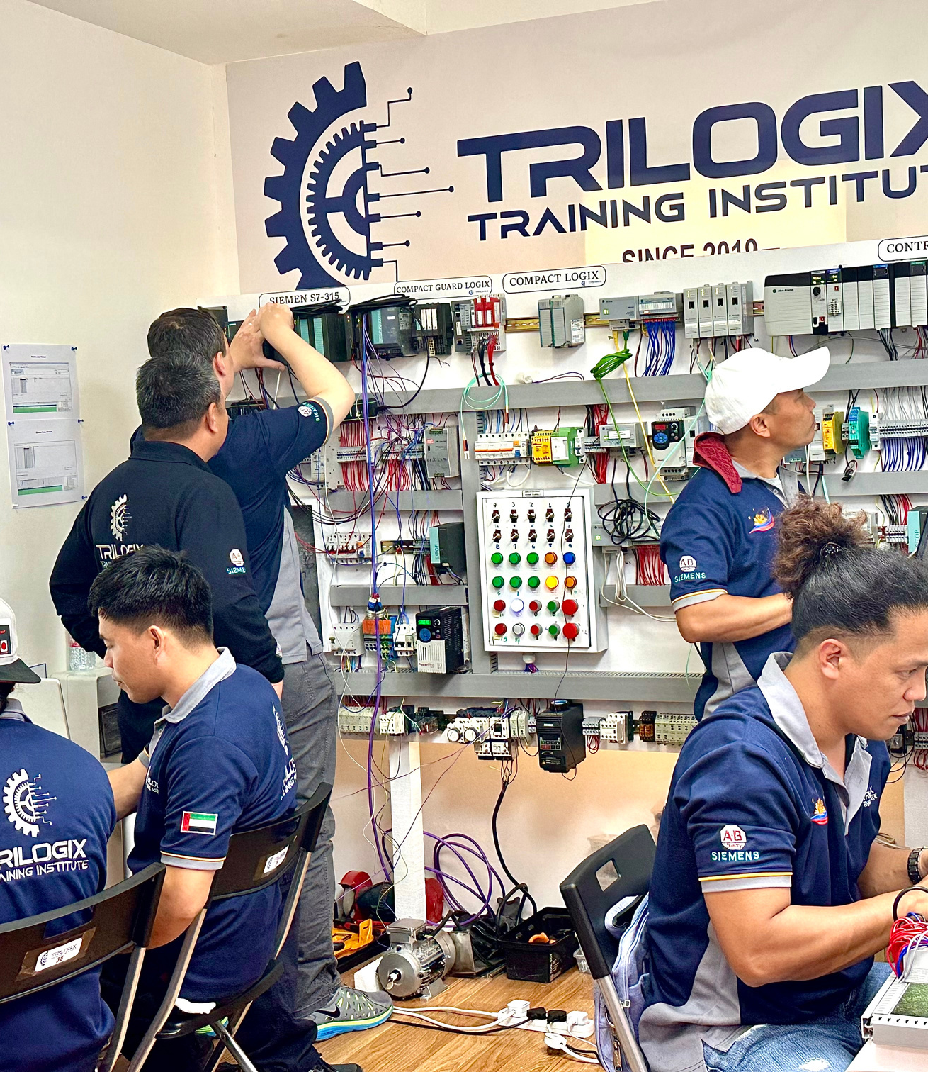



END OF THE PRESENTATION
THANK YOU FOR YOUR ATTENTION
TRILOGIX TRAINING INSTITUTE
+971506675357
(04) 3595338
www.trilogixtiatc.com

